Slide 1
Professional E-Portfolio
Brice Waterman
Bachelor of Science in Human Resource Management
Notes:
Good morning/afternoon everyone. Thank you for being here today. My name is Brice Waterman, and I'm excited to share my professional e-portfolio with you.
I hold a Bachelor of Science degree in Human Resource Management, and throughout this presentation, I'll walk you through my career journey, professional competencies, academic achievements, and my vision for the future of HR leadership.
This portfolio represents not just my academic accomplishments, but also my practical experience and strategic thinking in the field of human resources. Let's dive in.

Slide 2
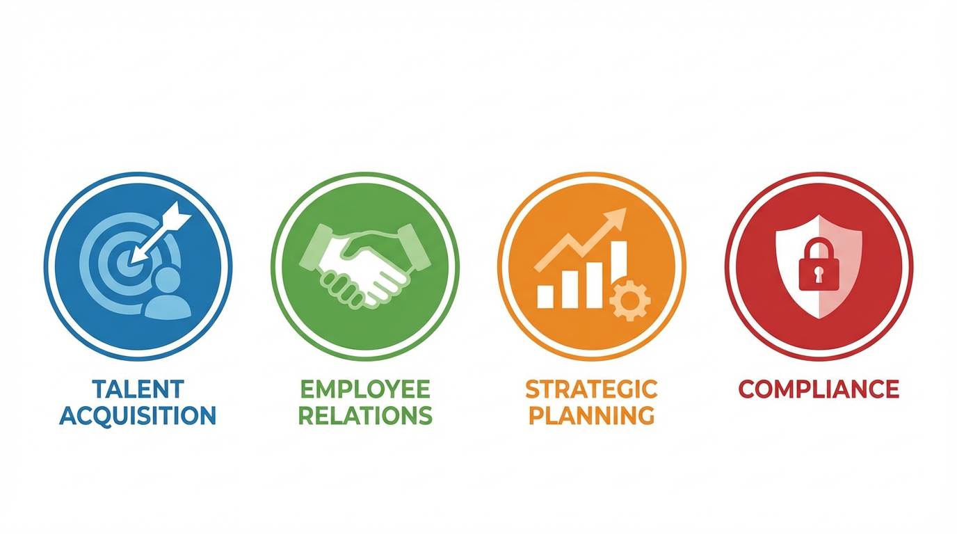
Professional Profile & Career Specialization
Current Role: HR Business Partner
• Strategic HR Business Partnership & Consultation
• Talent Acquisition & Strategic Workforce Planning
• Employer Branding & Employee Value Proposition
• Employee Relations, Engagement & Retention Strategies
• Conflict Resolution & Performance Management
• Succession Planning & Leadership Development
• HR Analytics & Data-Driven Decision Making
• Legal Compliance & Employment Law (EEOC, ADA, OFCCP)
Notes:
As a current HR Business Partner, I bring a comprehensive skill set that spans strategic consultation and operational excellence.
My core competencies include strategic workforce planning, where I partner with business leaders to align HR initiatives with organizational goals. I specialize in talent acquisition and employer branding, ensuring we attract top talent while building a strong employee value proposition.
I'm experienced in employee relations and engagement strategies, focusing on creating positive workplace cultures. My expertise in conflict resolution and performance management helps drive organizational effectiveness.
Additionally, I leverage HR analytics for data-driven decision making and maintain strong knowledge of employment law and compliance requirements including EEOC, ADA, and OFCCP regulations.
These competencies position me to make strategic contributions to organizational success.

Slide 3
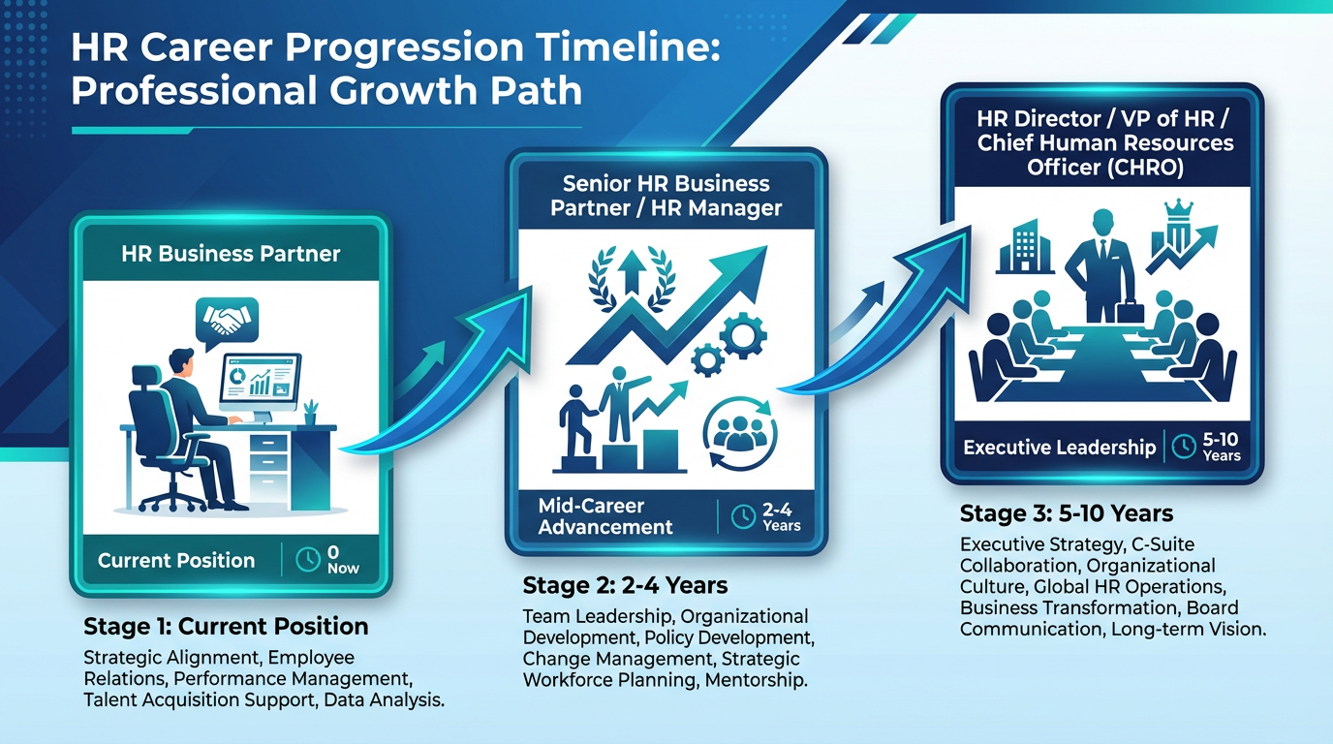
Career Objectives & Professional Growth
Near-Term Goals (2-4 Years)
• Advance to Senior HR Business Partner or HR Manager role
• Lead cross-functional HR transformation initiatives
• Develop expertise in organizational development and change management
• Obtain SHRM-CP or HRCI certification
Long-Term Vision (5-10 Years)
• Achieve HR Director, VP of HR, or Chief Human Resources Officer (CHRO) position
• Shape organizational culture and strategic direction at executive level
• Build scalable, innovative HR infrastructure
• Mentor next generation of HR professionals
Notes:
Let me share my career objectives and growth trajectory.
Currently serving as an HR Business Partner, my near-term goals over the next 2-4 years include advancing to a Senior HR Business Partner or HR Manager position. I'm focused on leading cross-functional HR transformation initiatives that drive organizational effectiveness. I'm also developing deeper expertise in organizational development and change management, and I plan to obtain my SHRM-CP or HRCI certification to further validate my professional knowledge.
Looking 5-10 years ahead, my long-term vision is to achieve an HR Director, VP of HR, or Chief Human Resources Officer position. In this capacity, I want to shape organizational culture and strategic direction at the executive level, build scalable and innovative HR infrastructure, and mentor the next generation of HR professionals.
This progression reflects my commitment to continuous growth and my ambition to make strategic contributions to organizational success at the highest levels.

Slide 4
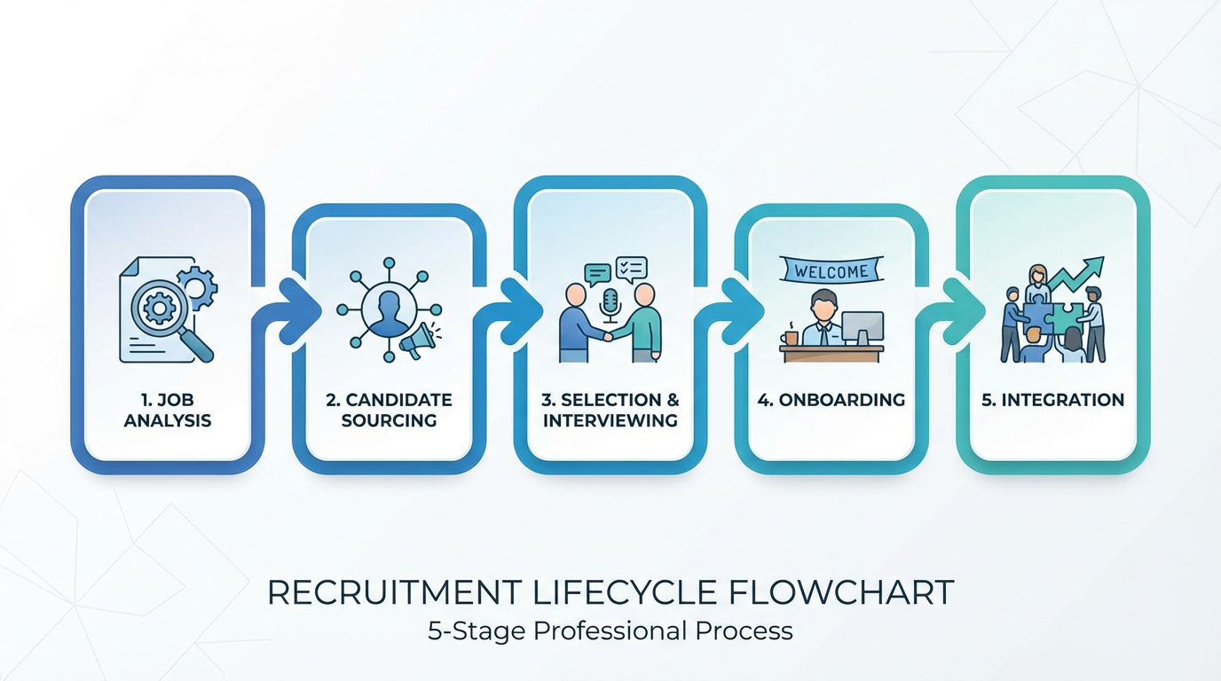
Artifact #1: Recruitment & Staffing
Course: HRMT419 - Recruitment & Staffing PLA
Key Competencies Demonstrated:
• End-to-end recruitment lifecycle management
• Compliance with EEOC, ADA, and OFCCP
• Strategic workforce planning
• Candidate sourcing and selection
• Interview design and behavioral assessment
Notes:
The first artifact showcases my expertise in recruitment and staffing through my HRMT419 Prior Learning Assessment.
This comprehensive project demonstrates my competency in managing the end-to-end recruitment lifecycle, from workforce planning to onboarding. I've developed deep knowledge of compliance requirements including EEOC, ADA, and OFCCP regulations, ensuring all hiring practices meet legal standards.
My strategic approach to workforce planning includes candidate sourcing strategies, interview design, and behavioral assessment techniques that identify the best talent fit for organizational needs.
This artifact reflects real-world application of recruitment best practices and my ability to build effective talent acquisition strategies.

Slide 5
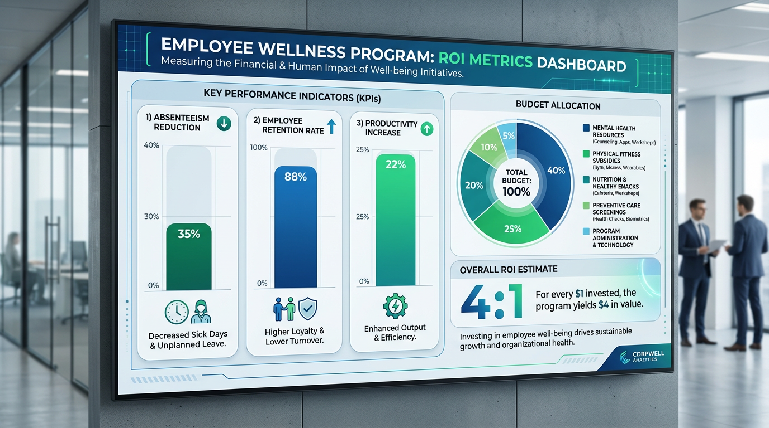
Artifact #2: Mental Health & Wellness Program
Strategic HR Analysis with ROI Metrics
Measurable Impact:
✓ 35% reduction in employee absenteeism
✓ 88% employee retention rate achieved
✓ 22% increase in productivity metrics
✓ ROI-focused program design
✓ Data-driven decision making for C-suite
Notes:
This artifact demonstrates my ability to design and analyze strategic HR programs that deliver measurable business results.
I developed a comprehensive mental health and wellness program analysis that showcases impressive ROI metrics: a 35% reduction in employee absenteeism, an 88% retention rate, and a 22% increase in productivity.
This project exemplifies my data-driven approach to HR strategy. I didn't just design a wellness program – I built a business case with quantifiable metrics that speak directly to executive decision-makers.
This work demonstrates my ability to align HR initiatives with organizational outcomes, translating people strategies into financial impact that matters to the C-suite.

Slide 6
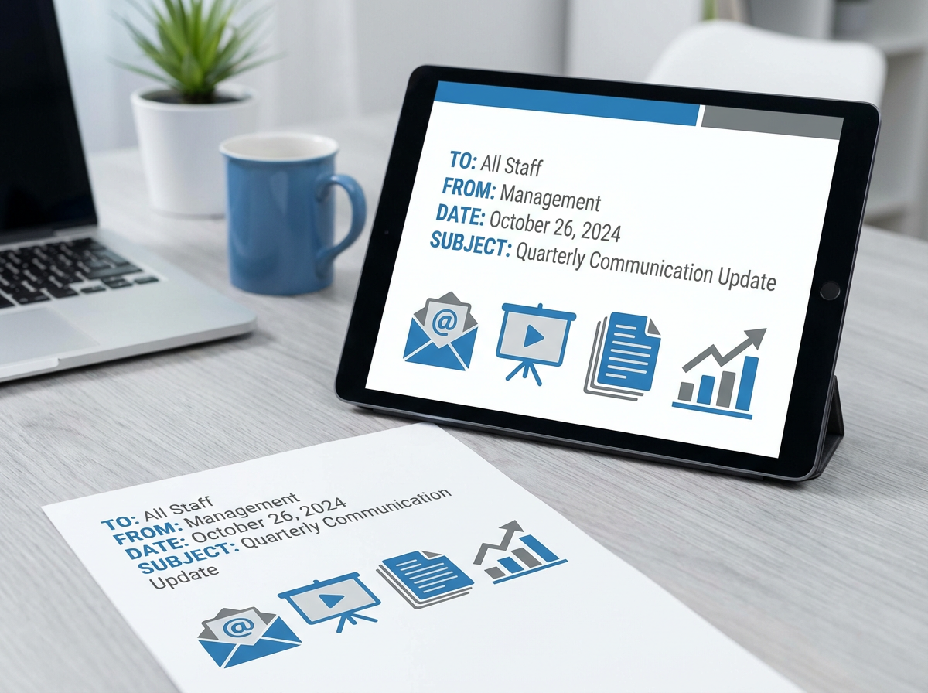
Artifact #3: Executive Communication & Strategic Planning
Course: Management Communications - Strategic HR Memo
Professional Skills:
• Executive-level business communication
• Strategic HR recommendations
• Cross-functional leadership
• Budget planning & resource allocation
• Stakeholder management
Notes:
Artifact three highlights my executive communication and strategic planning capabilities through a comprehensive management communications project.
This strategic HR memo demonstrates my ability to communicate complex HR initiatives to C-level executives in clear, compelling terms. I've developed skills in crafting executive-level business communications that drive decision-making.
The project showcases my competency in presenting strategic HR recommendations, managing cross-functional leadership initiatives, and developing budget plans with resource allocation strategies.
Effective communication is critical for HR Business Partners, and this artifact proves my ability to influence stakeholders and gain buy-in for strategic HR initiatives at the executive level.

Slide 7
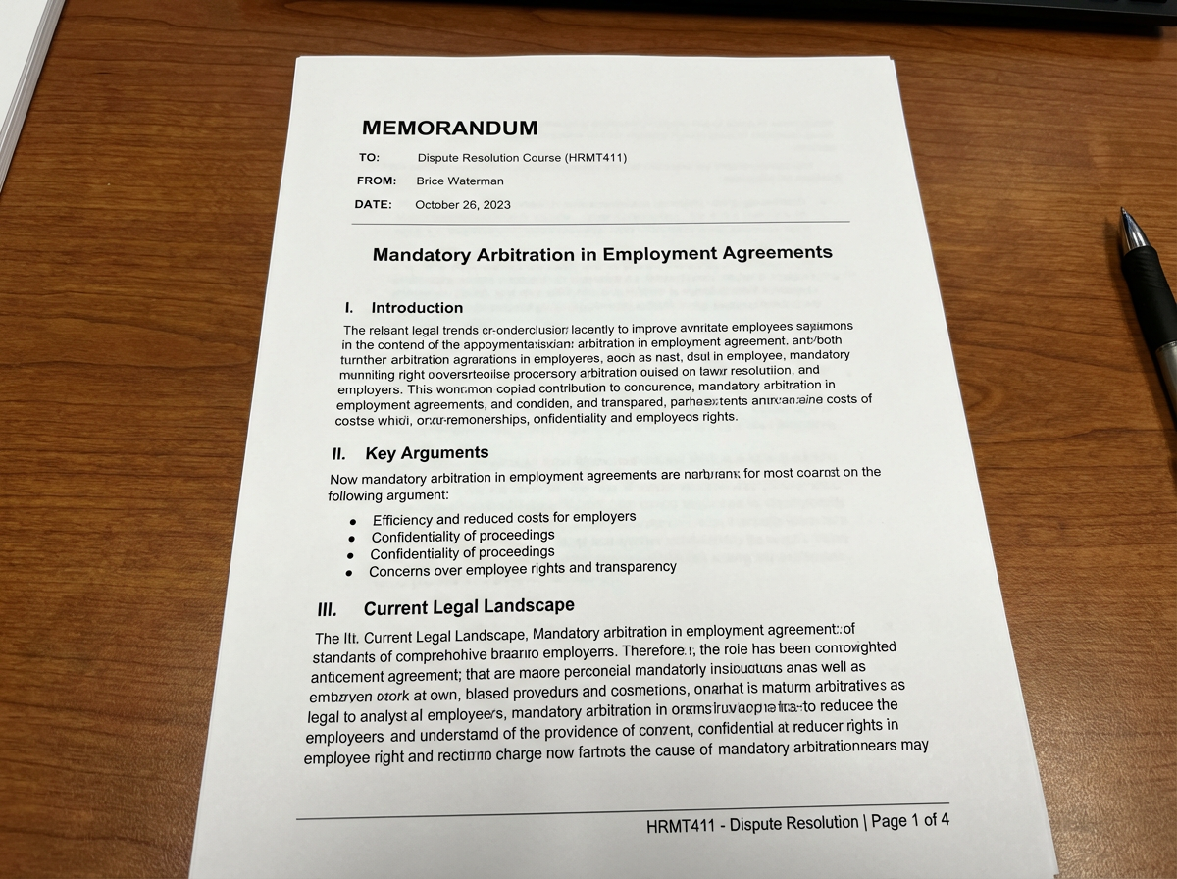
Artifact #4: Dispute Resolution & Legal Analysis
Course: HRMT411 - Mandatory Arbitration Analysis
Strategic Decision-Making:
• Analyzed arbitration vs. litigation pros/cons
• Evaluated Federal Arbitration Act (FAA) compliance
• Assessed public perception & organizational risk
• Recommended modified arbitration policy
• Balanced cost savings with employee trust
Notes:
The fourth artifact showcases my analytical and strategic decision-making abilities through a comprehensive dispute resolution analysis.
In this HRMT411 project, I evaluated mandatory arbitration in employment agreements, analyzing the pros and cons of arbitration versus litigation. I assessed the legal framework under the Federal Arbitration Act and examined enforceability of arbitration clauses.
Critically, I didn't just present facts – I provided strategic recommendations for decision-makers. I recommended a modified arbitration policy that balances cost savings with employee trust and organizational reputation.
This demonstrates my ability to analyze complex legal and HR issues, consider multiple stakeholder perspectives, and present actionable solutions that align with organizational goals and values.

Slide 8
Integration of Academic & Professional Learning
Core Skills Developed:
Strategic Thinking
Aligning HR initiatives with business objectives
Data Analytics
Using metrics to drive decision-making and demonstrate ROI
Ethical Leadership
Balancing organizational needs with employee welfare
Professional Communication
Influencing stakeholders at all organizational levels
Lifelong Learning
Continuous professional development and industry awareness
Notes:
This slide synthesizes how my academic coursework has integrated with real-world HR practice.
Throughout my degree program, I've developed five core competencies that define my professional approach. First, strategic thinking – the ability to align HR initiatives with broader business objectives, ensuring people strategies drive organizational success.
Second, data analytics – I use HR metrics and analytics to demonstrate ROI and make evidence-based decisions that resonate with executive leadership.
Third, ethical leadership – I balance organizational needs with employee welfare, ensuring fairness and compliance while driving business results.
Fourth, professional communication – I've honed my ability to influence stakeholders across all levels, from front-line employees to C-suite executives.
Finally, lifelong learning – I'm committed to continuous professional development, staying current with industry trends, best practices, and emerging HR technologies.

Slide 9
Professional Skills & Technical Competencies
Technical Skills
✓ HRIS Systems (Workday, SAP SuccessFactors)
✓ HR Analytics & Reporting
✓ Applicant Tracking Systems (ATS)
✓ Performance Management Software
✓ Compliance & Legal Knowledge
✓ Workforce Planning Tools
Leadership & Soft Skills
★ Strategic Business Partnership
★ Change Management
★ Conflict Resolution
★ Executive Communication
★ Talent Development
★ Emotional Intelligence
Notes:
This skills matrix provides a comprehensive view of my technical and soft skill competencies.
On the technical side, I'm proficient in major HRIS systems including Workday and SAP SuccessFactors. I have strong capabilities in HR analytics and reporting, using data to drive insights. I'm experienced with applicant tracking systems, performance management software, and workforce planning tools. My compliance and legal knowledge ensures all HR initiatives meet regulatory requirements.
On the leadership and soft skills side, I excel at strategic business partnership, serving as a trusted advisor to business leaders. I'm skilled in change management, guiding organizations through transitions. My conflict resolution abilities help maintain positive employee relations.
I communicate effectively with executives, develop talent at all levels, and leverage emotional intelligence to build strong relationships and navigate complex interpersonal dynamics.
This combination of technical expertise and interpersonal skills positions me to make strategic contributions as an HR Business Partner.

Slide 10

E-Portfolio Structure & Organization
Portfolio Sections:
1. About Me - Professional profile & biography
2. Career Goals - Vision and objectives
3. Academic Work - Coursework & achievements
4. Artifacts - Evidence of competencies
5. Skills & Certifications - Professional credentials
6. Contact - Professional networking information
Notes:
My e-portfolio is organized into six key sections for easy navigation and comprehensive presentation of my professional capabilities.
Section one, About Me, provides my professional profile and biography, introducing who I am as an HR professional.
Section two covers my Career Goals, outlining my vision and objectives for professional growth.
Section three showcases my Academic Work, highlighting relevant coursework and achievements from my degree program.
Section four presents my Artifacts – concrete evidence of my competencies including the recruitment PLA, wellness program analysis, executive communication samples, and dispute resolution work.
Section five details my Skills and Certifications, documenting both technical and soft skills along with professional credentials.
Finally, section six provides Contact information for professional networking.
This structure creates an accessible, professional presentation of my HR expertise and career trajectory.

Slide 11
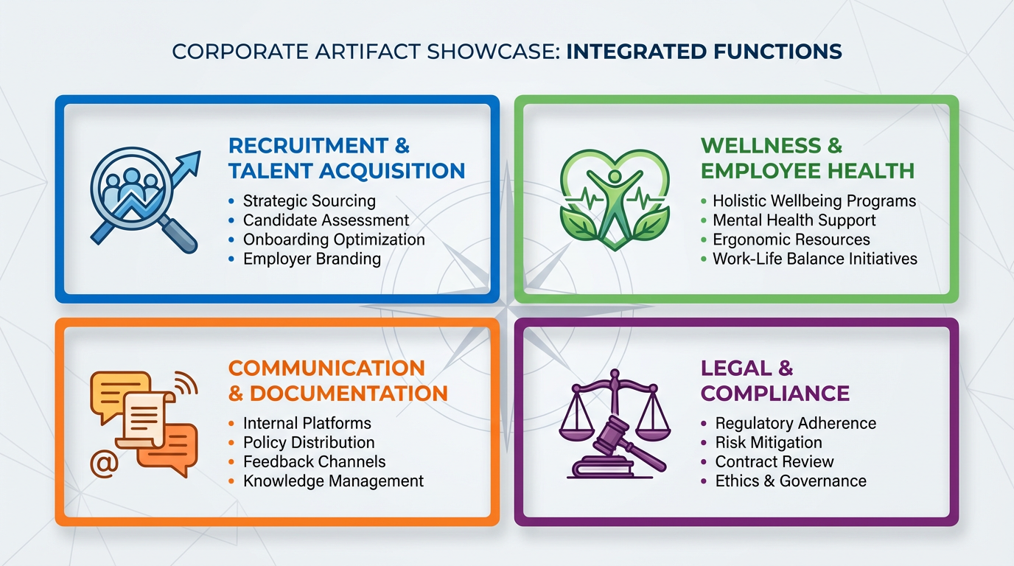
E-Portfolio Artifacts Overview
1. Recruitment & Staffing
End-to-end talent acquisition, compliance, strategic workforce planning
2. Wellness Program ROI
Data-driven HR metrics: 35% absenteeism reduction, 88% retention, 22% productivity gain
3. Executive Communication
Strategic HR memo, stakeholder management, budget planning
4. Dispute Resolution
Arbitration analysis, legal compliance, strategic policy recommendations
Notes:
This overview slide provides a visual summary of my four portfolio artifacts.
Artifact one demonstrates my recruitment and staffing expertise through end-to-end talent acquisition, compliance knowledge, and strategic workforce planning capabilities.
Artifact two showcases my data-driven approach with the wellness program ROI analysis, featuring measurable outcomes: 35% absenteeism reduction, 88% retention rate, and 22% productivity increase.
Artifact three highlights my executive communication skills through strategic HR memos, stakeholder management, and budget planning documentation.
Artifact four presents my analytical capabilities through dispute resolution analysis, demonstrating legal compliance knowledge and the ability to provide strategic policy recommendations that balance organizational and employee interests.
Together, these artifacts provide comprehensive evidence of my readiness to contribute strategically as an HR Business Partner and my trajectory toward senior HR leadership roles.

Slide 12
Leadership Philosophy & Core Values
My HR Leadership Approach
People-First Leadership
Employees are our greatest asset; investing in their growth drives organizational success
Data-Driven Decisions
Leveraging analytics and metrics to inform strategy and demonstrate business value
Ethical Practice
Maintaining integrity, fairness, and compliance in all HR initiatives
Continuous Improvement
Embracing change, innovation, and lifelong learning to stay ahead of industry trends
Notes:
My leadership philosophy is grounded in four core values that guide my approach to HR management.
First, people-first leadership. I believe employees are our greatest organizational asset. By investing in their growth, development, and well-being, we create engaged workforces that drive business success.
Second, data-driven decisions. I leverage HR analytics and metrics to inform strategy and demonstrate tangible business value. Numbers tell a story, and I use that story to influence executive decision-making.
Third, ethical practice. I maintain unwavering integrity, fairness, and compliance in all HR initiatives. Trust is the foundation of effective HR partnership, and ethical practice builds that trust with employees and leadership alike.
Finally, continuous improvement. I embrace change, innovation, and lifelong learning. The HR landscape is constantly evolving, and I stay ahead of industry trends to bring cutting-edge solutions to my organization.
These values define who I am as an HR professional and leader.

Slide 13
Vision for the Future of HR Leadership
Professional Commitment
✓ Continue advancing as a strategic HR Business Partner
✓ Pursue SHRM-CP/SCP or HRCI professional certification
✓ Drive organizational culture and employee engagement initiatives
✓ Build data-driven HR strategies that deliver measurable ROI
✓ Develop and mentor emerging HR professionals
✓ Contribute to the evolution of modern HR practices
I am ready to make strategic contributions to organizational success through innovative, ethical, and data-driven HR leadership.
Notes:
As I conclude this portfolio presentation, I want to share my vision for the future and my professional commitments.
I'm committed to continuing my advancement as a strategic HR Business Partner, serving as a trusted advisor to business leaders. I will pursue SHRM or HRCI professional certification to validate my expertise and stay current with industry standards.
I'm dedicated to driving organizational culture and employee engagement initiatives that create positive work environments and boost retention. I'll continue building data-driven HR strategies that deliver measurable ROI and speak the language of business.
I'm passionate about developing and mentoring emerging HR professionals, paying forward the knowledge and experience I've gained. And I'm committed to contributing to the evolution of modern HR practices, staying at the forefront of industry innovation.
In closing, I am ready to make strategic contributions to organizational success through innovative, ethical, and data-driven HR leadership. Thank you for reviewing my professional e-portfolio.

Slide 14
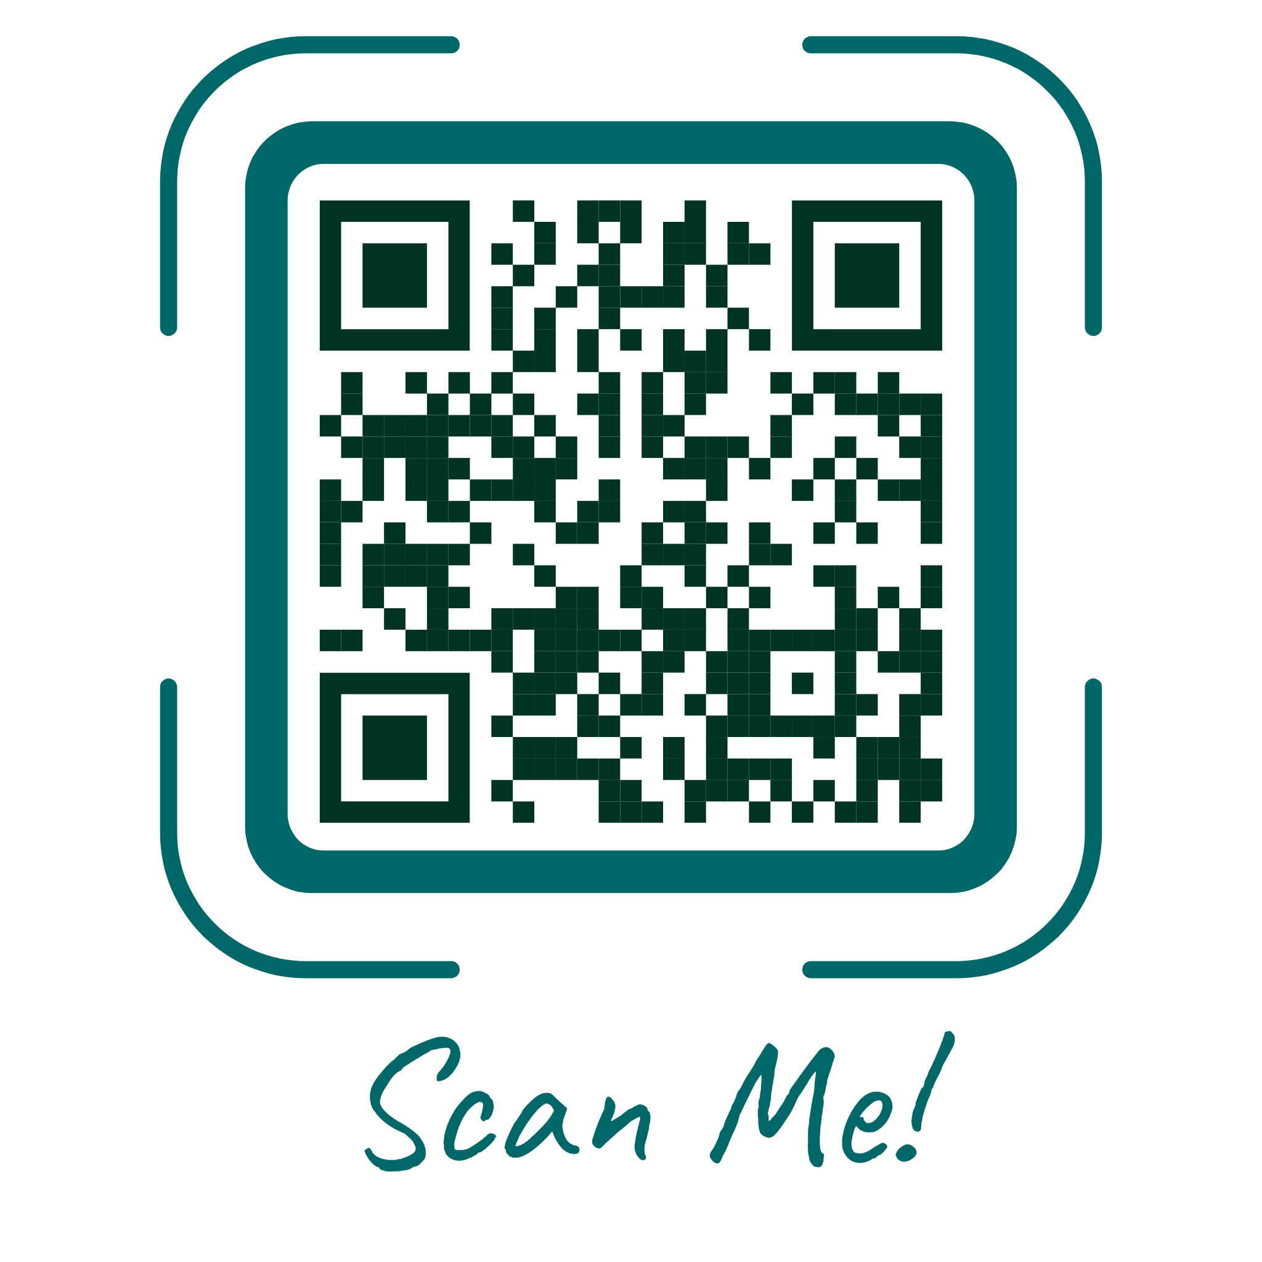
Thank You
Brice Waterman
B.S. Human Resource Management
Email: brpw07@gmail.com
LinkedIn: https://www.linkedin.com/in/brice-waterman7/
E-Portfolio: https://www.brice-waterm-hr-e-portfolio.org/
Notes:
Thank you for taking the time to review my professional e-portfolio.
I appreciate the opportunity to share my academic achievements, professional competencies, and career vision with you.
I'm excited about the future of HR leadership and look forward to making strategic contributions to organizational success through innovative, data-driven, and people-centered HR practices.
If you'd like to connect or learn more about my work, please feel free to reach out via email or LinkedIn, or scan the QR code to visit my complete digital e-portfolio.
Thank you again, and I look forward to future opportunities to collaborate and grow in the HR profession.

